Slide 1
FINANCIAL AID for 2023-2024
Shaunté Middleton
Educational Talent Search
Binghamton University

Slide 2
TRIO Educational Talent Search Binghamton University Shaunté Middleton Counselor 607-777-5436 smiddle@binghamton.edu

Slide 3
The Educational Talent Search Program assists low income, first generation students in applying for college and financial aid.

Slide 4
Financial Aid comes in several forms and from several sources. Federal State Local College
Grants Scholarships Loans

Slide 5
The Financial Aid process begins with filing the FAFSA. Free Application for Federal Student Aid. www.FAFSA.GOV www.studentaid.gov

Slide 6
Here is a quick video overview of the Financial Aid process. https://www.youtube.com/watch?v=emUDDQSFYRI

Slide 7
You can file a FAFSA beginning October 1st. You will need income information from 2021. That includes your taxes and any untaxable income.
This Photo by Unknown Author is licensed under CC BY-SA

Slide 8
Filling out the FAFSA form https://www.youtube.com/watch?v=w9HWaQpuNSk

Slide 9
You can begin the process now by getting an FSA ID Username and Password to use as an electronic signature. https://www.youtube.com/watch?v=yj1Pn-shze8

Slide 10
What is a SAR? Student Aid Report
Your Student Aid Report (SAR) is an electronic or paper document that gives you some basic information about your eligibility for federal student aid. It also includes your answers to the questions on the Free Application for Federal Student Aid (FAFSA®) form.
You will receive it in your email 1-3 days after you submit a signed FAFSA.
BE SURE TO READ YOUR SAR!
It will let you know if you have made any errors and will tell you how much Pell Grant money and Student Loan eligibility you have.

Slide 11
You will find a direct link to the New York State TAP application on the confirmation page of the FAFSA. Click there if you would like to “Start your state application”.

Slide 12
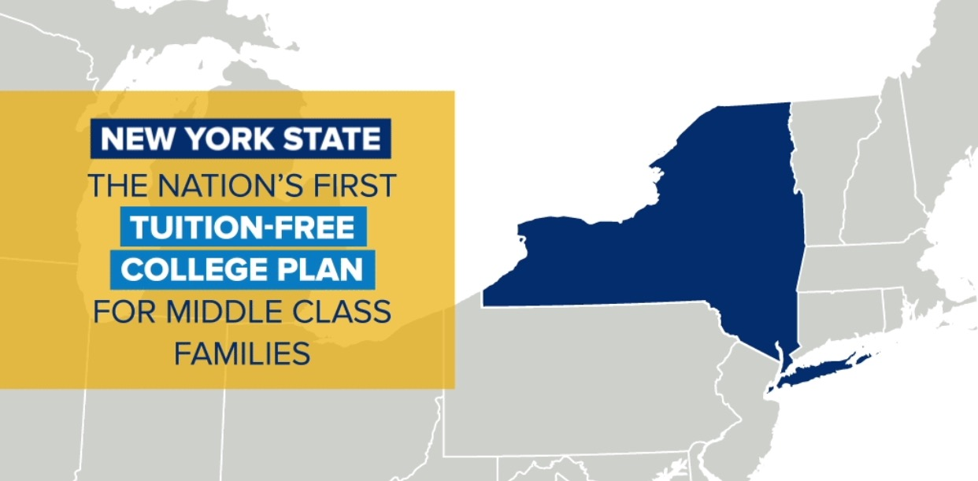
HESC.NY.GOV is also the place to apply for the NYS Excelsior Scholarship. $125,000 income limit this year. LAST DOLLAR SCHOLASHIP

Slide 13
www. HESC.NY.GOV/ TOTW https://www.youtube.com/watch?v=gB30ASXhCho

Slide 14
Once you completed the your FAFSA and TAP… AM I DONE WITH FINANCIAL AID?
Well….NO.
This is actually just the beginning of your financial aid process!

Slide 15
Your college will assign you an online account. This account is where you can see what types of Financial Aid you have been offered. You will need to ACCEPT or DECLINE your financial aid offer in this account. You will also use this account to register for classes, create your schedule,see your grades.

Slide 16
Once you see how much you have in
FREE MONEY, you can determine if you will need STUDENT LOANS.
DON’T FORGET TO CHECK WITH THE HS GUIDANCE OFFICE ABOUT SCHOLARSHIPS!
Most colleges will also offer payment plans to pay college costs
A
BE SURE TO CHECK YOUR EMAIL OFTEN!
DO NOT IGNORE EMAILS SENT TO YOU BY YOUR COLLEGE.

Slide 17
Remember to file for Financial Aid every year! Keep records of your usernames and passwords. Ask for help if you need it.
EDUCATIONAL TALENT SEARCH Binghamton University
Shaunté Middleton
smiddle@binghamton.edu
607-777-5436

